Slide 1
HTML FORMS

Slide 2
Summary of the previous lecture
Creating tables in HTML
Table attributes
Page lay-out using tables

Slide 3
Outline
HTML FORMS
HTML FORM elements

Slide 4
1. HTML FORMS
Forms provide a means of submitting information from the client to the server
HTML supports tags for creating forms, however, it does not process the information
Use server-side script to process form information
Server-side script runs on the Web server and receives data from a form and uses it to perform a set of tasks

Slide 5
1. HTML FORMS…
This figure shows how a Web page form interacts with a CGI script.

Slide 6
1. HTML FORMS…
<form> tag is used to start a form
</form> tag is used to end a form
Between <form> and </form>, form elements are placed
We can declare a form as:
<form attributes>
form elements and layout tags
</form>
A single page can include several different
forms, but you cannot nest one form
inside another

Slide 7
1. HTML FORMS…
Common Form Attributes:
action - gives the URL of the application that is to receive and process the forms data
method - sets the HTTP method that the browser uses to send the form's data to the server for processing; Either POST or GET
name – name of the form

Slide 8
2. Form Elements
Textbox
Password Field
Hidden Field
Checkbox
Radio Button
Text Area
Select List
Submit Button
Reset Button

Slide 9
2.1 Text box
<INPUT TYPE=“TEXT” >
NAME
SIZE
VALUE
MAXLENGTH
<INPUT TYPE=“TEXT” NAME=NAME SIZE=30 VALUE=“ALI” MAXLENGTH=15>

Slide 10
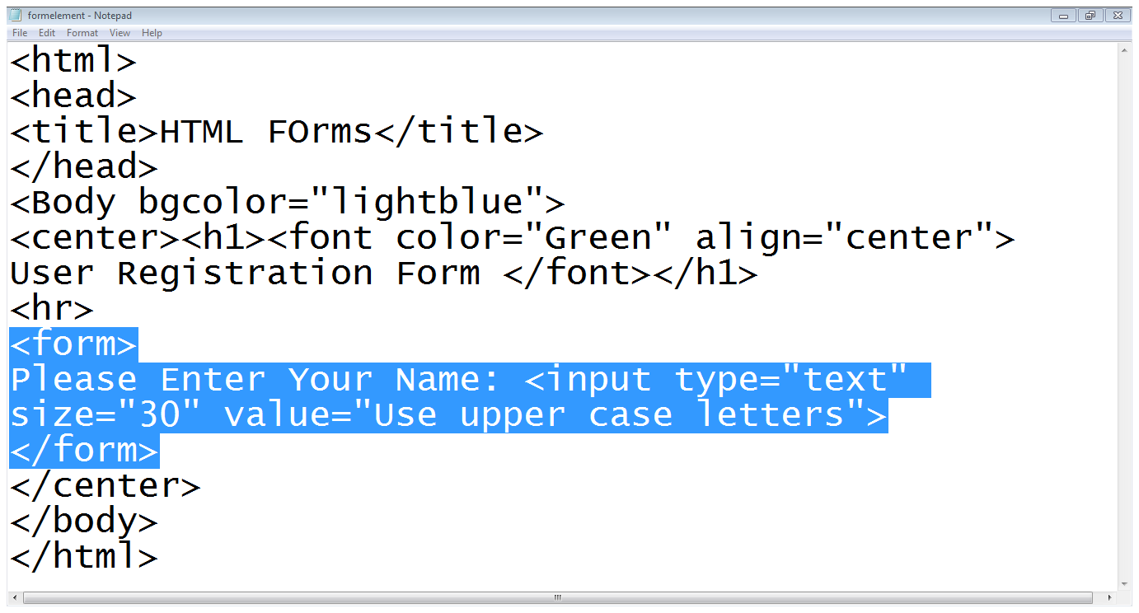
2.1 Text box…
Start of the form
label
Text box

Slide 11
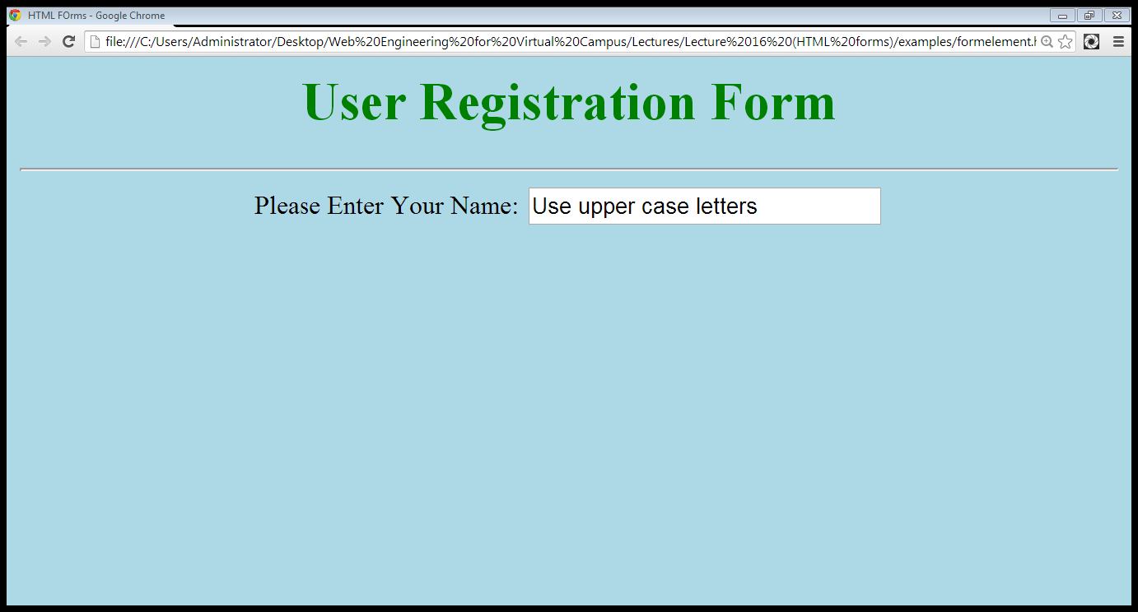
2.1 Text box…
value
label
Text box

Slide 12
2.2 Password Field
<INPUT TYPE=“PASSWORD”>
NAME
SIZE
VALUE
MAXLENGTH
<INPUT TYPE=“PASSWORD” NAME=NAME SIZE=30 VALUE=“ALI” MAXLENGTH=15>

Slide 13
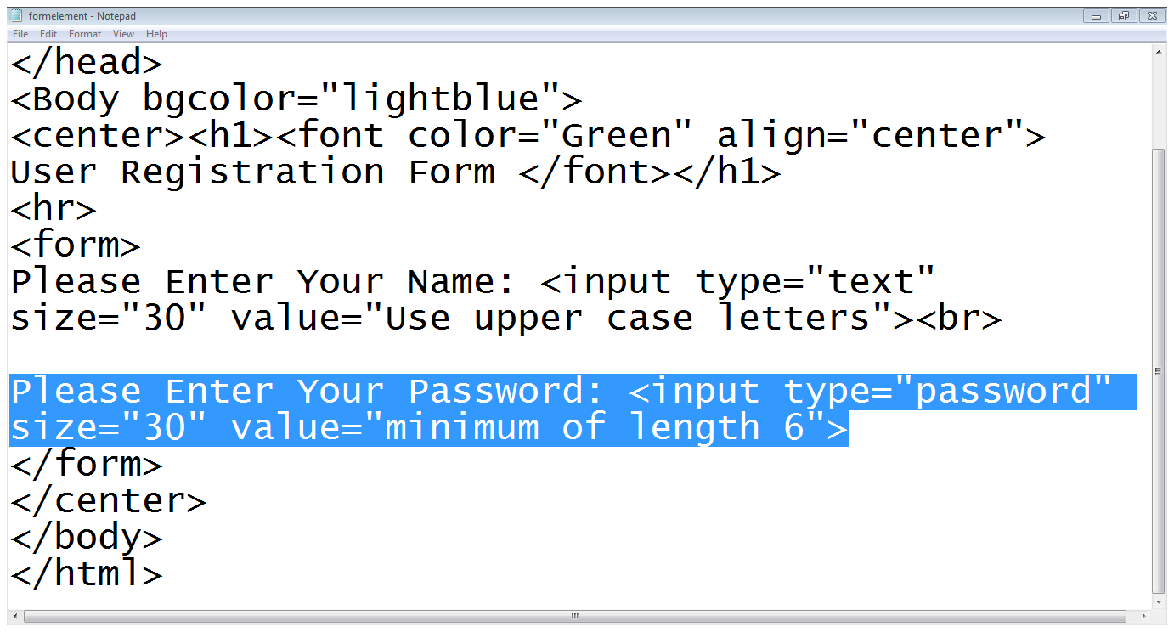
2.2 Password Field…
Type is password

Slide 14
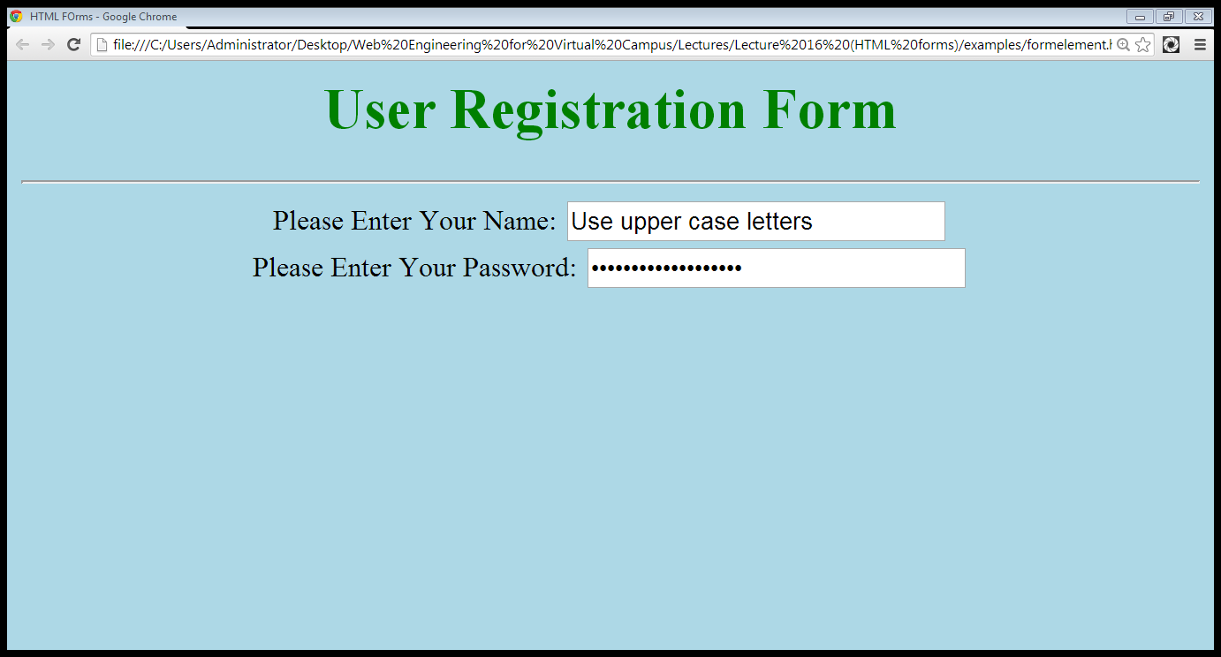
2.2 Password Field…
Typed characters are hidden

Slide 15
2.3 Hidden Text Field
<INPUT TYPE=“HIDDEN”>
NAME
VALUE
<INPUT TYPE=“HIDDEN” NAME=NAME VALUE=“ALI” >

Slide 16
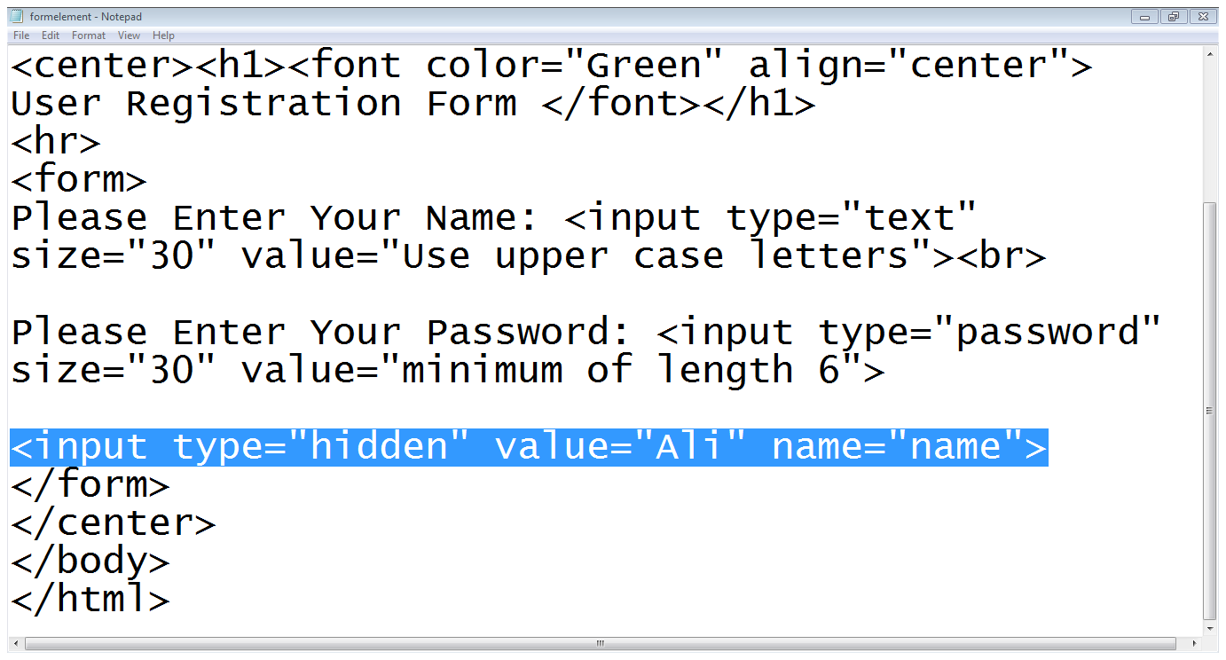
2.3 Hidden Text Field…
Type is hidden

Slide 17

2.3 Hidden Text Field…
Hidden field is not visible

Slide 18
2.4 Checkbox
<INPUT TYPE=“CHECKBOX”>
CHECKED
NAME
VALUE
<INPUT TYPE=“CHECKBOX” NAME=“CHECK” VALUE=“ CHECKED”>

Slide 19
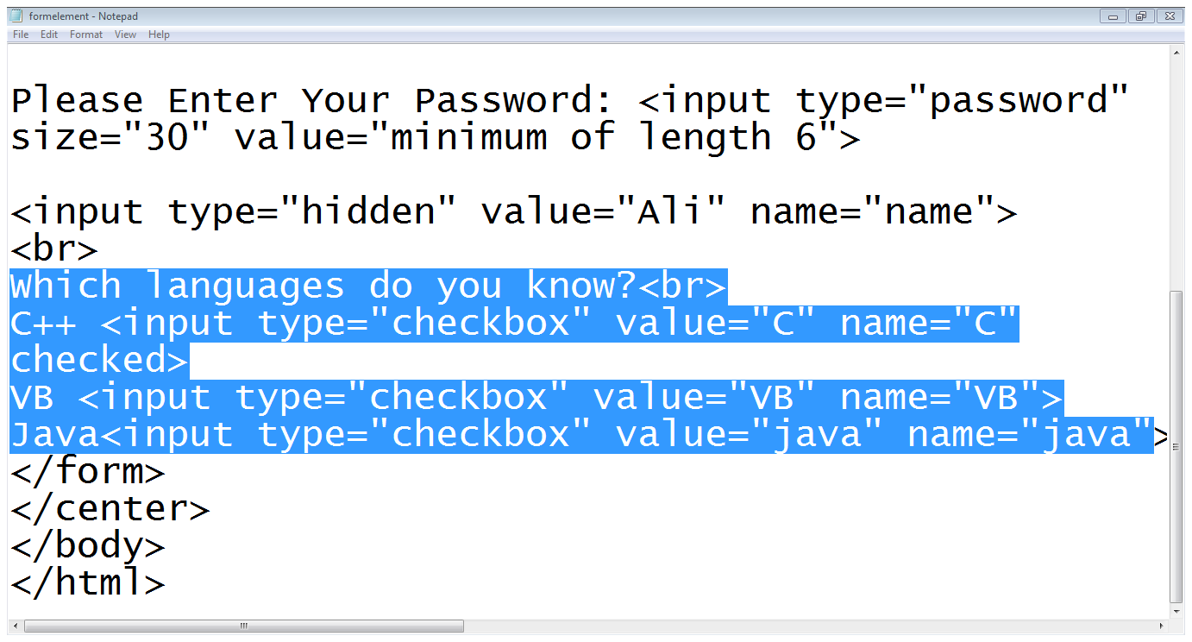
2.4 Checkbox…
label
Type
option
value
checked

Slide 20
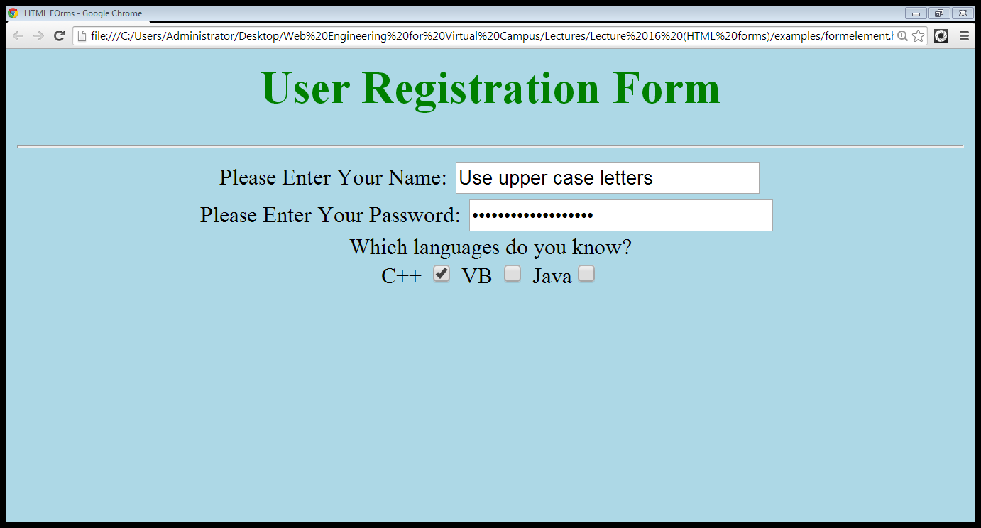
2.4 Checkbox…
label
Already checked
Options

Slide 21
2.5 Radio Buttons
<INPUT TYPE=“RADIO”>
CHECKED
NAME
VALUE
<INPUT TYPE=“RADIO” NAME=“RADIO” VALUE=“” CHECKED>MALE
<INPUT TYPE=“RADIO” NAME=“RADIO” VALUE=“” >FEMALE

Slide 22
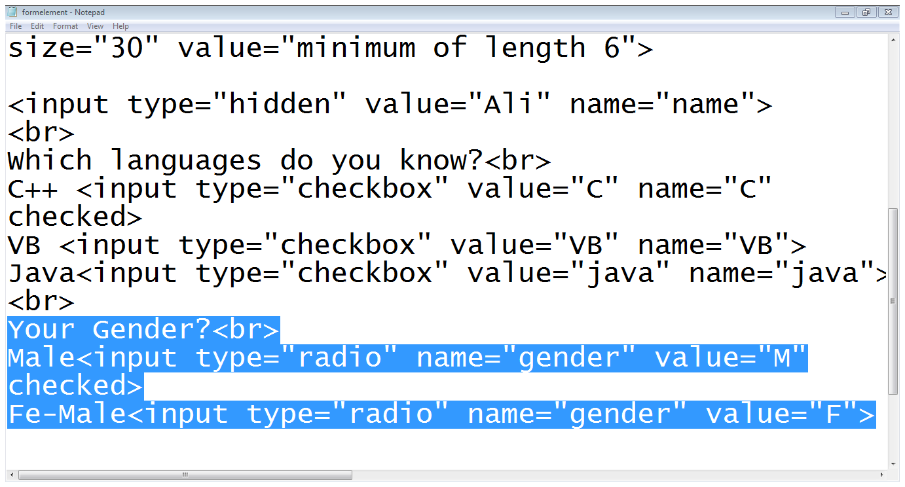
2.5 Radio Buttons…
label
Option
type
Same name

Slide 23
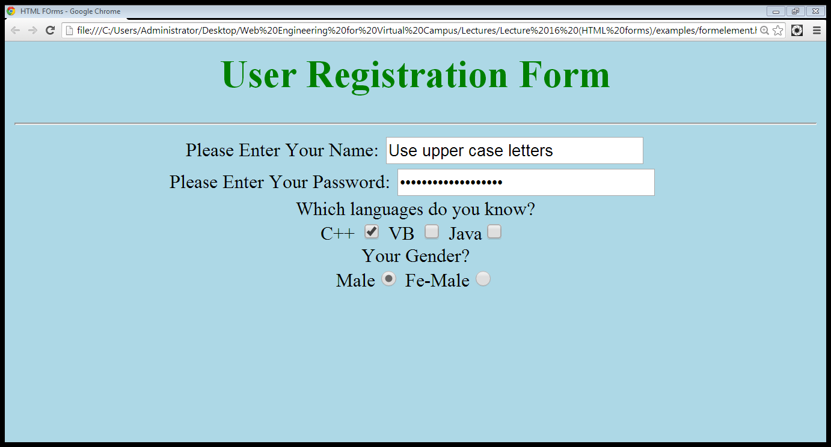
2.5 Radio Buttons…
Radio Button
Already checked

Slide 24
2.6 Select list
Drop down list:
Select
Name, size
Option
<SELECT name=“name” size=“size”>
<OPTION value=“lahore”>LAHORE</option>
<OPTION value=“karachi”>KARACH</option>
<OPTION value=“islamabad”>ISLAMABAD</option>
</SELECT>

Slide 25
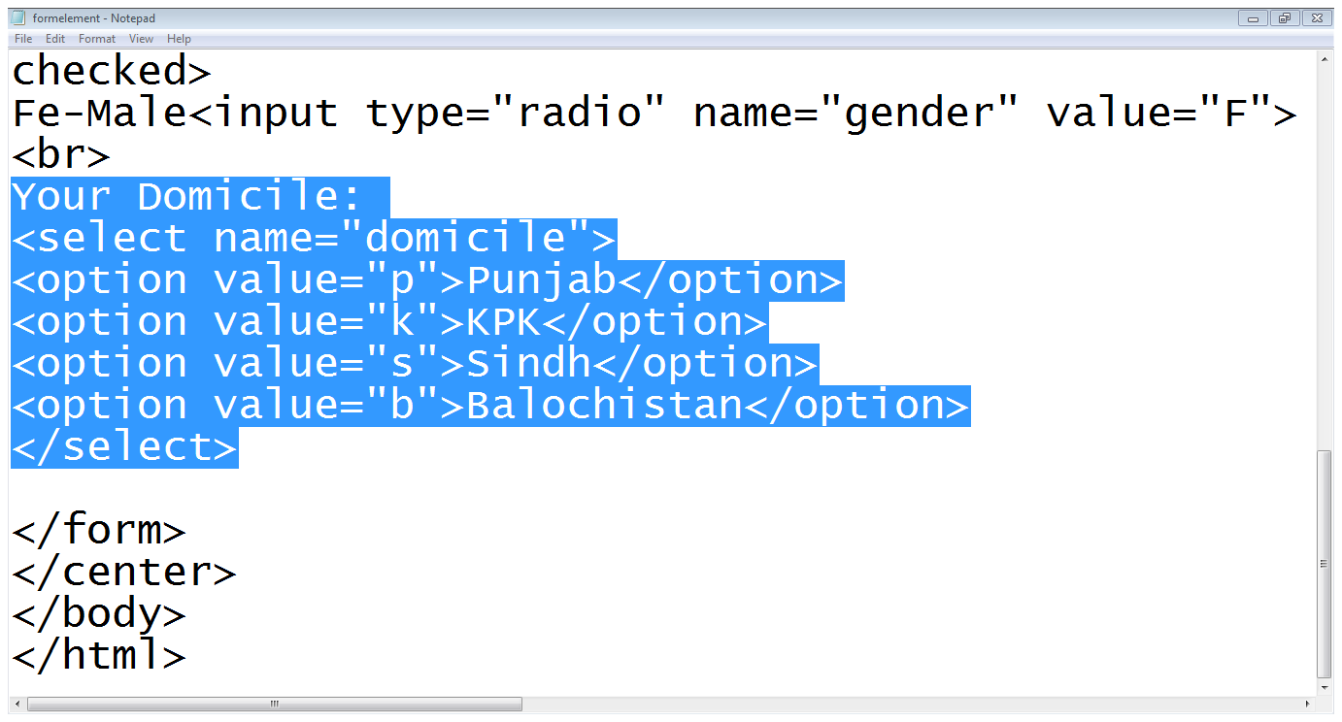
2.6 Select list…
List starts
options
Select ends

Slide 26
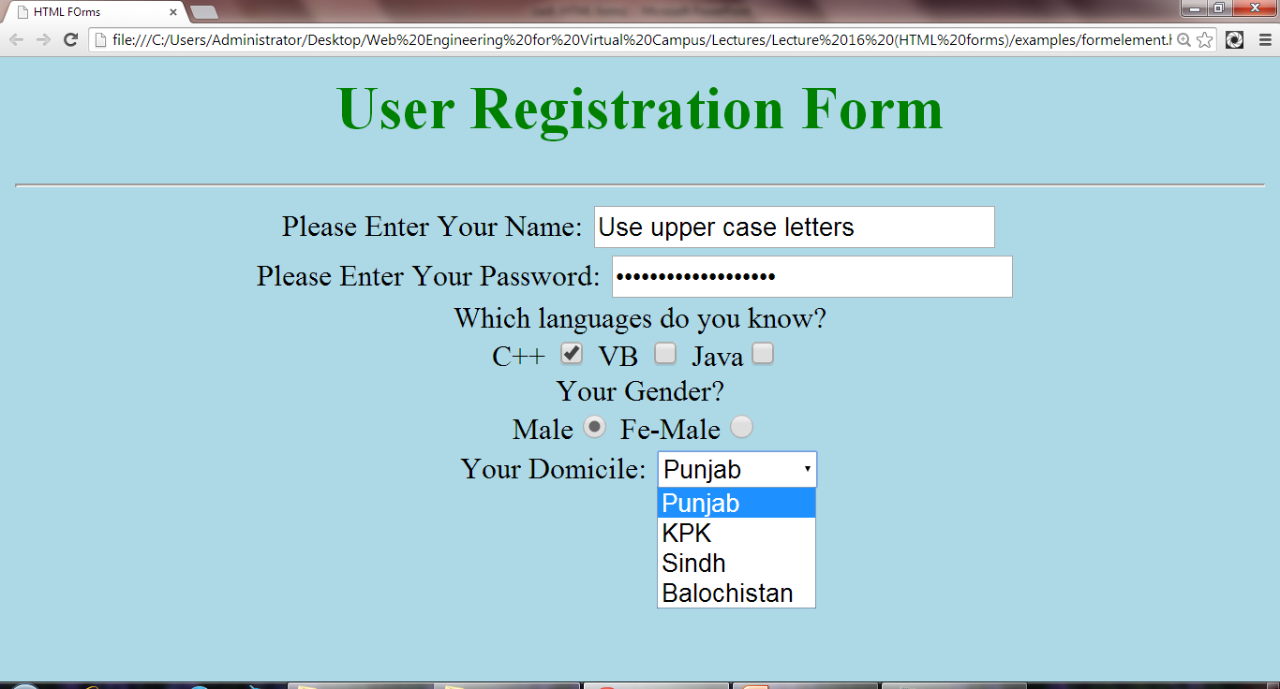
2.6 Select list…
Select list with options

Slide 27
2.7 Text area
Text-area
Rows
Cols
Name
<TEXTAREA rows=“5” cols=“5”>
Default text
</TEXTAREA>

Slide 28
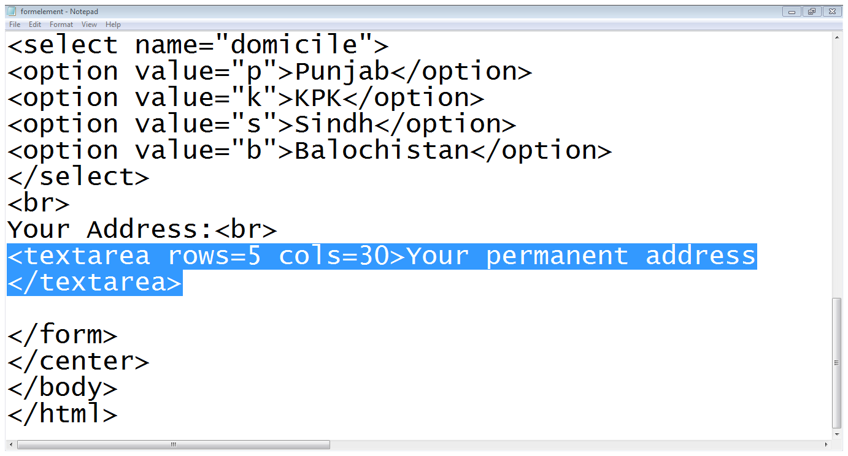
2.7 Text area…

Slide 29
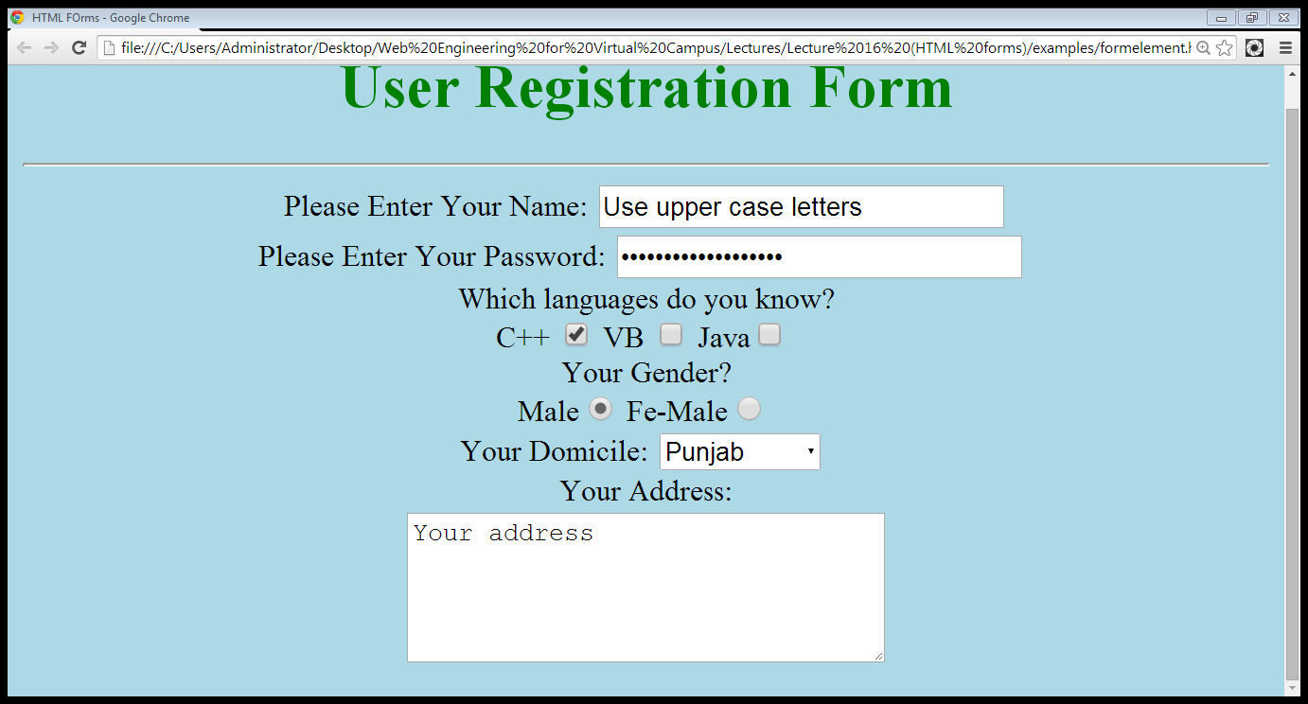
2.7 Text area…
Text area

Slide 30
2.8 File field
File-field
<input type=“file” name=“file-name”>

Slide 31
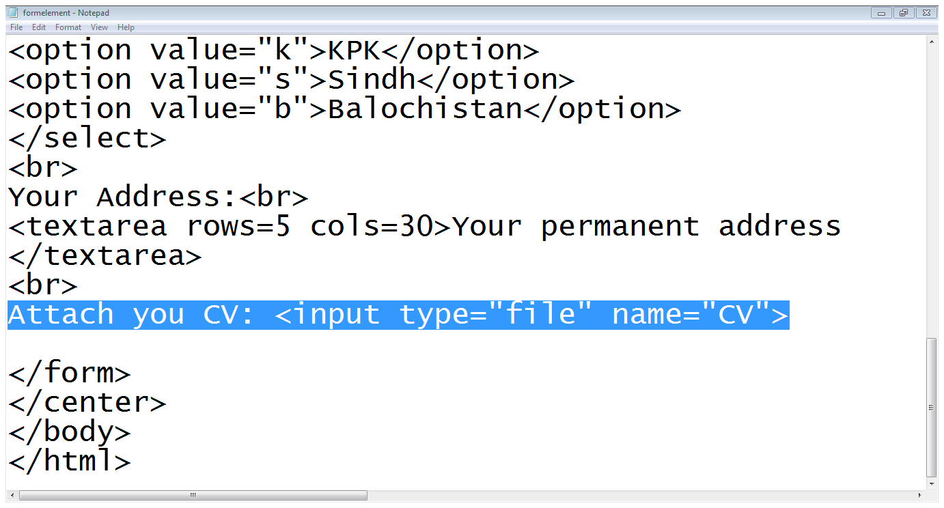
2.8 File field…

Slide 32
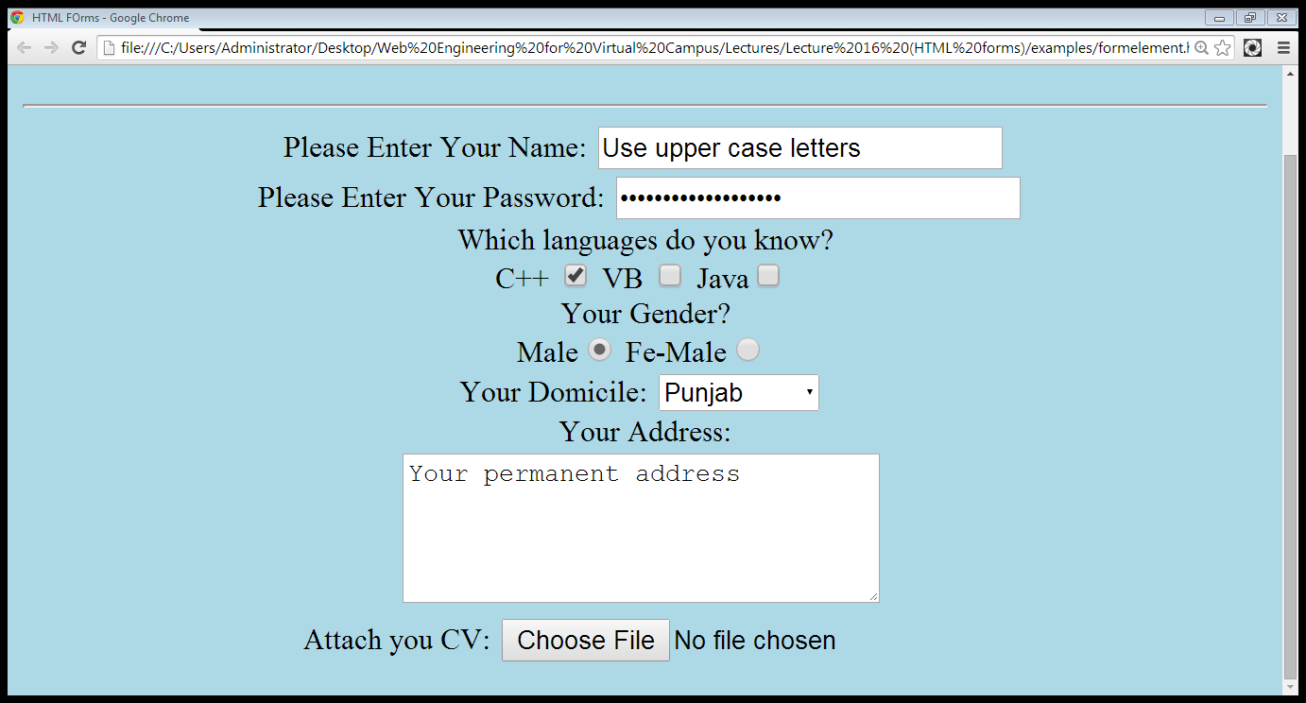
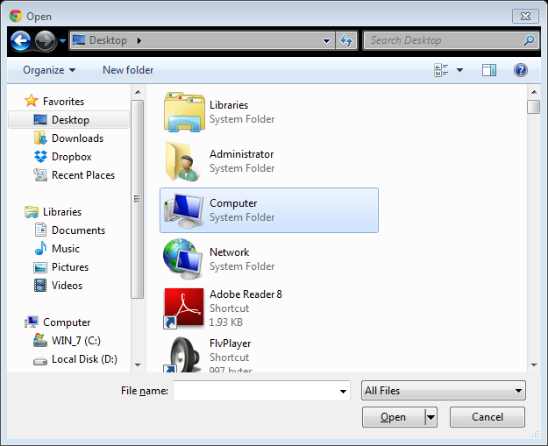
2.8 File field…

Slide 33
2.9 Submit and Reset buttons
Submit and Reset Buttons
<INPUT TYPE=“SUBMIT” VALUE=“SAVE”>
<INPUT TYPE=“RESET” VALUE=“RESET”>

Slide 34
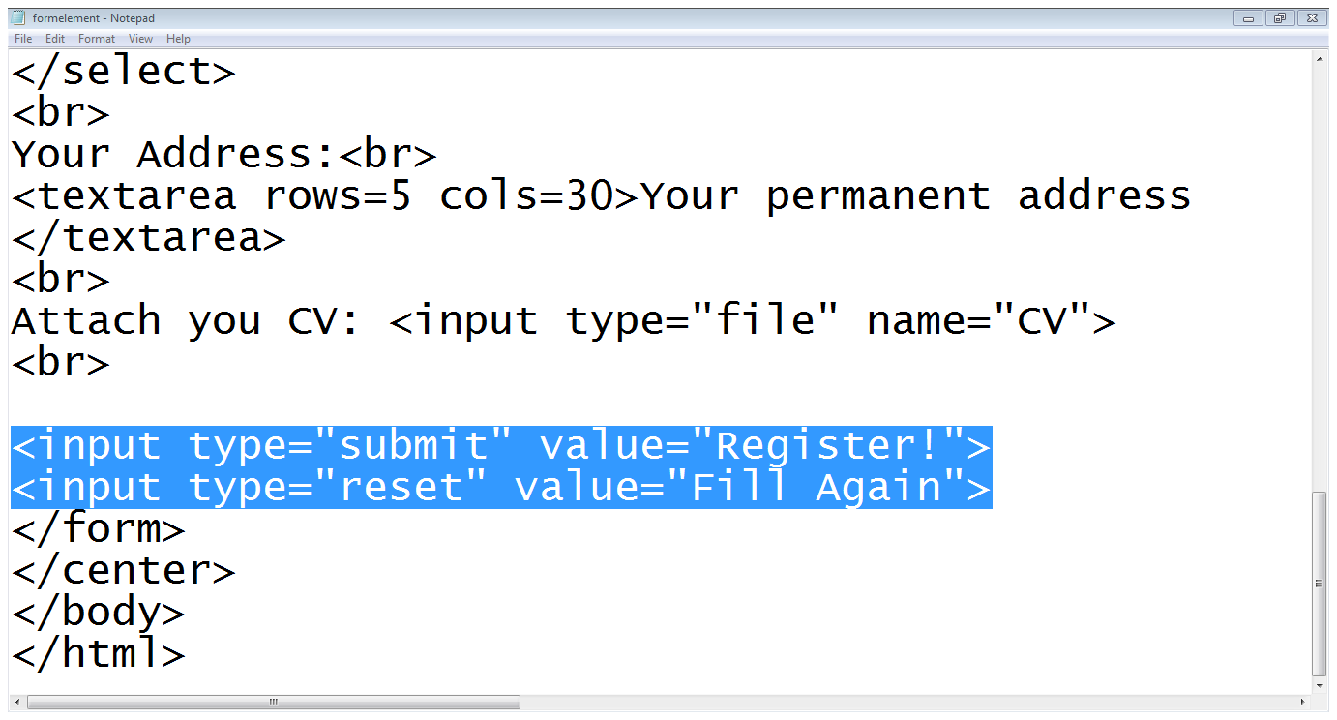
2.9 Submit and Reset buttons…
Submit button
Reset button

Slide 35
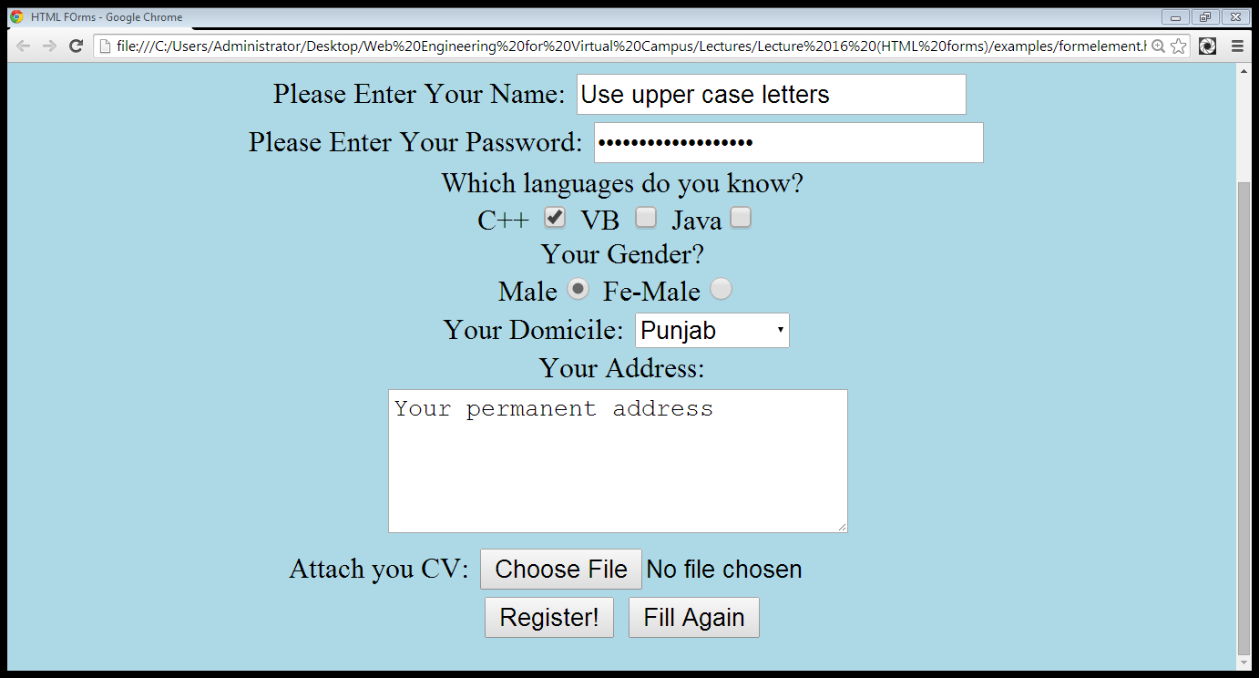
2.9 Submit and Reset buttons…
Submit
Reset

Slide 36
Summary
Creating forms in HTML
Adding form elements

Slide 37
References
Chapter 5, Beginning HTML, XHTML,CSS, and JavaScript, by Jon Duckett, Wiley Publishing; 2009, ISBN: 978-0-470-54070-1.

